Slide 1

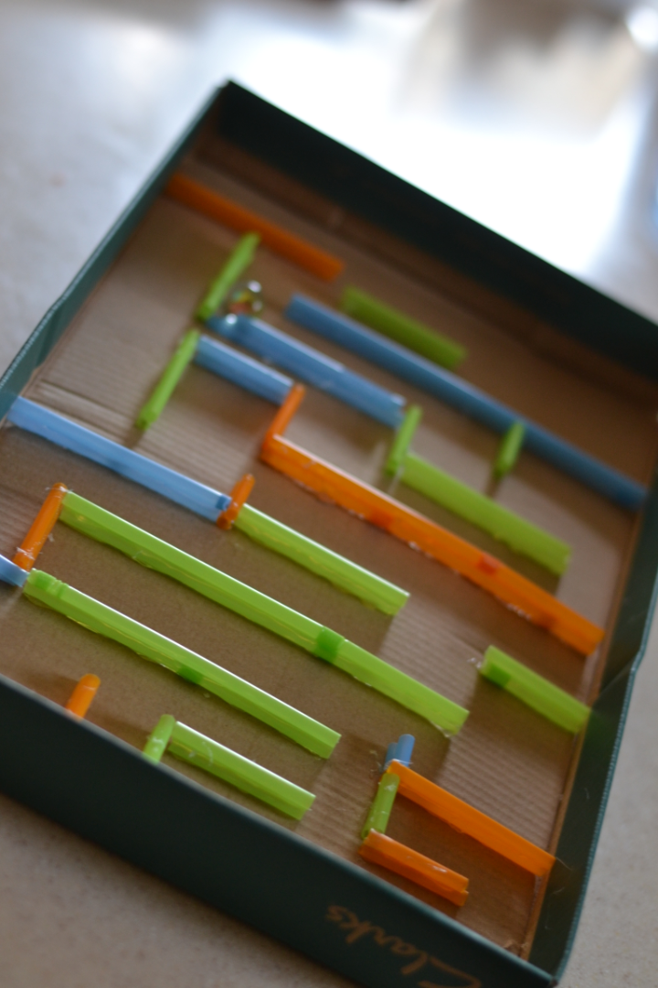
Marble Maze using Raspberry Pi
Team Members:
Ashwin - CB.EN.U4CCE21010
Kabil Pranav K - CB.EN.U4CCE21028
Pranav Jayakrishna - CB.EN.U4CCE21046
Yathis Kumar D - CB.EN.U4CCE21079

Slide 2

Introduction
Creating a thrilling marble maze game on your Sense HAT's LED matrix. Utilize the built-in orientation sensors to steer a virtual marble through the maze, replicating real-world physics. It's a hands-on blend of classic gaming and sensor-driven interactivity on your Raspberry Pi.

Slide 3
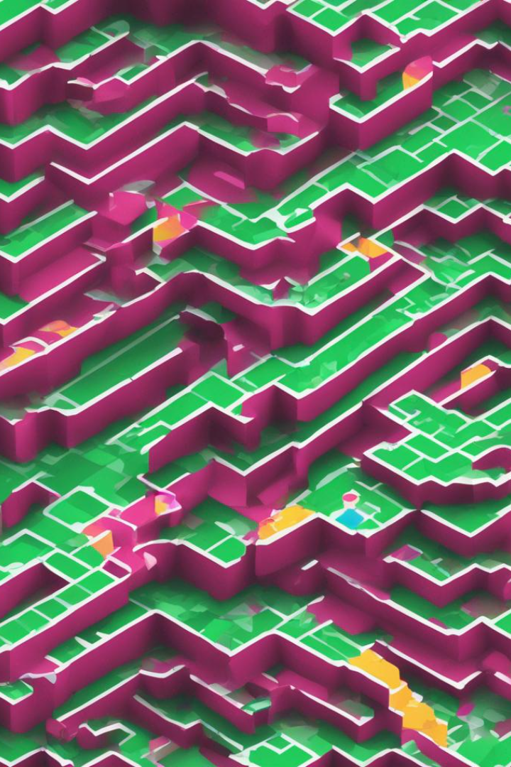
Abstract
Players navigate a virtual marble through mazes by tilting the Raspberry Pi, leveraging the Sense HAT's accelerometer data. The objective is to reach the green endpoint while avoiding red obstacles. Each level has a time limit, and completion leads to the next level. The game is visually displayed on the Sense HAT's LED matrix, providing an interactive and educational Python programming experience on the Raspberry Pi platform.

Slide 4
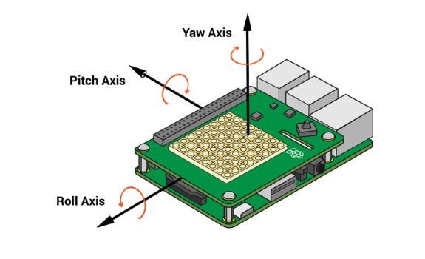
Circuit Diagram:

Slide 5

Working Principle
Initialization: The script sets up the necessary environment by importing libraries, initializing the Sense HAT, and defining color variables.
Display and Play Functions: Functions are created to display levels and control gameplay. The play function manages the virtual marble's movement using pitch and roll sensor data.
Move Marble Function: Determines the marble's new position based on sensor values, adjusting for valid moves and handling collisions with maze walls.
Check Wall Function: Ensures the marble doesn't pass through walls by validating the new position against the maze layout.
Check Win Function: Identifies if the marble reaches the goal, declaring victory when the goal is reached.
Level Definitions: Predefined levels are represented as matrices, defining unique maze layouts. Additional levels can be easily added.
Level Iteration: The script iterates through levels, displaying, playing, and updating the score. If the player loses a level, the loop breaks, and the final score is displayed.
Score Display: The Sense HAT shows a message at the end, indicating the player's final score based on completed levels.

Slide 6
Output

